Slide 1
Customer Service
H.O.P.E SUMMIT
2018
Notes:
Where do we begin when identifying effective customer service? 5 minutes

Slide 2
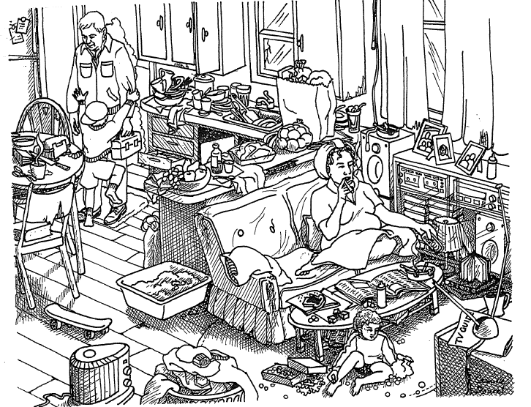
Family Strengths Drawing

Slide 3
What Strengths Do You See?
Food Employed Family Pictures Two Parents
Place to Live Groceries Television Closeness
Heat Sound System Refrigerator Happy Child
Toys/Skateboard Humidifier Telephone Books
Washing Machine Table/Chairs Budget Clothing
Pet Fresh Air Fire Extinguisher Medicine
Class 1
Fruit/Vegetables Dad greeting Child Groceries/Snacks Cat/Pet
Furniture Running Water Books Shelter
Curtains Pantry Bottle Heater
Newspaper Electricity Television Extension Cord
Lamp Lunch Box Refrigerator Coffee
Budget Radio Family Time Transportation
Floor is solid Shared Responsibility
Class 2
Notes:
15 minute brainstorm

Slide 4
Putting Yourself In Their Shoes
An important first step for effective customer service is Empathy. In other words, being able to understand a persons needs, feelings, or point of view free of judgement.
What does empathy mean to you?
How do you and your team provide judgement free customer service?

Slide 5
Participant responses
WHAT DOES EMPATHY MEAN TO YOU?
Class 1
Greeting customers properly
Caring
Put yourself in their shoes
Feel what they feel
Feel important/needed
Respect
Help any way you can
Accept language barrier
Class 2
Putting yourself in their shoes
All equal
Empathy vs Sympathy- Knowing the difference
Notes:
15 minutes

Slide 6
Participant responses
How does your agency provide “judgement free” customer services ??
Class 1
Smile- How’s your day! Client Choice Coffee/Snack Resources
Handouts for services Display/ Meals Special Dinners Holidays
Hug Thank them Remind then not to be embarrassed
Listen to them Respect/Family Recipes/Meals Birthday bags
Manager sets a good example
Class 2
Train volunteers Finding volunteer strengths Form relationships
Diffuse situations Self reflection Number system for customers

Slide 7
Notes:
I will leave you with this. It is a Common thread that connects us all. Post at your agency where your clients and team can see it. 5 minutes Ann Marie reads aloud

