Slide 1
Collaborations
By: Kelly Burke
Agency Services Compliance Coordinator

Slide 2
Definition Collaboration
1. General: Cooperative arrangement in which two or more parties (which may or may not have any previous relationship) work jointly towards a common goal.

Slide 3
Definition Collaboration:
2. Knowledge management: Effective method of transferring 'know how' among individuals, therefore critical to creating and sustaining a competitive advantage.

Slide 4
Definition Collaborations:
3. Negotiations: Conflict resolution strategy that uses both assertiveness and cooperation to seek solutions advantageous to all parties. It succeeds usually where the participants' goals are compatible, and the interaction among them is important in attaining those goals.
- Businessdictionary.com

Slide 5
Reasons Why Agencies Don’t Collaborate
Never thought about it
Don’t know who to partner with
Don’t want to seem like you don’t know what you are doing – “I can handle this”
Feel like others may be in competition with your program for resources
Don’t want others telling us what we should do
Time consuming
Let’s discuss some of these misconceptions.

Slide 6
Reasons Why You Should Collaborate:
Networking – the more people and programs you know, the more you can stay in touch with the many services available
Knowledge – We all have information to share
Funding – increasingly, funders are looking to see that they aren’t paying for duplicate services and want to see more collaborative efforts.

Slide 7
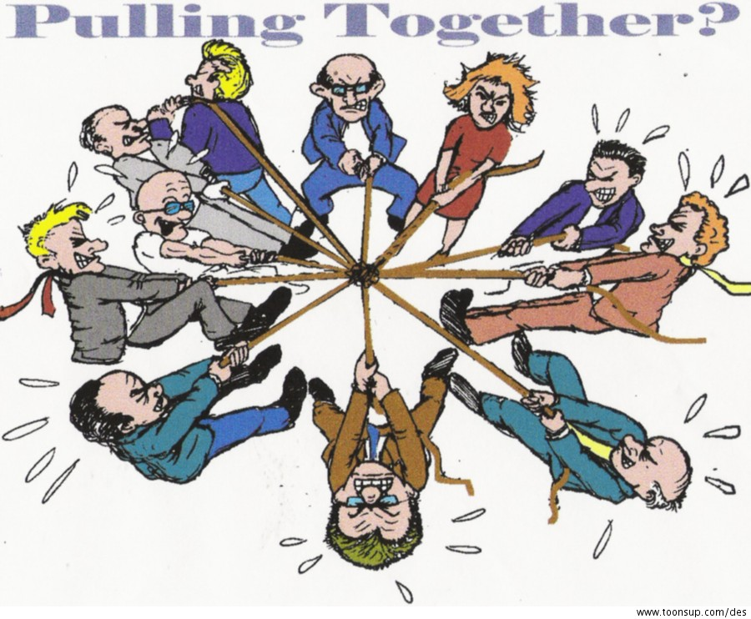
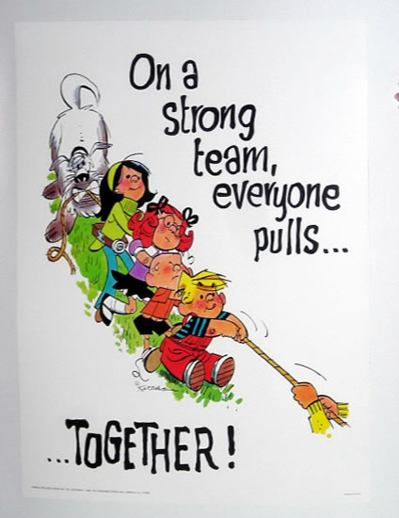
Which Method are You Employing?

Slide 8
Types of Collaborations
Networks
Coalitions
Movements
Strategic Alliances
Strategic Co-Funding
Public-Private Partnership
Collective Impact Initiatives
Hand-out elaborating this.

Slide 9
Examples of Collaborations
Sharing perishable food pick-ups from outside sources
Sharing one of the Food Bank’s Mobile Pantries – clients, responsibilities and location
Working with other non-profits with volunteer opportunities. Group homes residents may be looking for meaningful volunteer experiences.
Working together on a fund-raiser.

Slide 10
Examples of Collaborations (continued)
Working together on a awareness campaign
Bouncing ideas off each other on ways things work best such as with client choice at pantries
Pantry coalitions to meet to discuss service areas, concerns and upcoming events
Working with your local government agencies to get support

Slide 11
Where to Start
Think about an area of need, a goal you have or an area of interest where you think would be beneficial.
Sit down with your team and brainstorm ideas of where to look or identify connections people have. (This is a collaboration already!)
Tip: scrolling through 211WNY.org can be a great place to look! (They are here today!)
Put together on paper a clear and realistic set of things you are looking for and goals you would like to meet.

Slide 12
Next
Reach out to those you have come up with. The formality of this will vary based on whom you are contacting. (A local non-profit you may be able to start with a phone call. A politician perhaps needs a letter).
Let them know your needs/interests and have reasons why it would be of interest to them as well. (Remember a collaboration is meant to benefit all parties.)
Arrange a meeting and be prepared for it

Slide 13
Listen to Their Needs
When you meet, listen to their needs and think about ideas that could work for everyone.
For those that are creative and open to new ideas, this can be a very exciting time and wonderful to hear fresh input or a different side of the story or angle on things.
This may even open your eyes to new possibilities.

Slide 14
Keys to a Successful Collaboration
Clear and realistic expectations
Documentation on what each participant agrees upon as their role/responsibility so there is no confusion
Meet regularly to keep the momentum going and assure all parties are meeting their deadlines/responsibilities and address issues or opportunities
Be prepared to adjust goals or tactics as needed, with all parties agreeing

Slide 15
What if a Collaboration is No Longer Working?
Remember, the purpose of collaborations is for all parties to mutually benefit
If their comes a time when it is no longer working, first try to realign the group.
It is not a collaboration if any of the parties are being overburdened
It is ok to step back on good terms and leave future opportunities open.

Slide 16
Start Right Away
Start collaborating right away. Many of your best allies are right in this room, others may be at the information tables in the hall!
It doesn’t have to be big to make a big difference.

Slide 19
Retail Donation Programs
By: Omar Parra
Food Sourcing Coordinator

Slide 20
Our Neighbors
Cattaraugus county: 9,241 individuals (17.5%) live in poverty. Those numbers reflect 2,781 families.
Chautauqua county: 19,878 individuals (19.4%) live in poverty. Those numbers reflect 5,547 families.
Erie county: 95,090 individuals (12.7%) live in poverty. Those numbers reflect 31,599 families.
Niagara county: 15,573 individuals (13.6%) live in poverty. Those numbers reflect 5,416 families.
Data based on statistics from Feeding America Map the Meal Gap 2018; New York State Community Action Association New York State Poverty Report 2018; and Food Bank of WNY, as of March 2018.
Notes:
85% are high-school graduates, and of those, 31% are college educated
39% are employed, 33% are unemployed and actively seeking work
28% are not working because they are retired or are disabled and cannot work
27% of the adults assisted are currently serving or have served in the military
Those who struggle with hunger are often forced to choose between basic necessities over purchasing nutritious food

Slide 21
Retail Partnership
What is a Retail Partnership?
The importance of the partnership
Established retail partnership program (Feeding America)
Agency participation

Slide 22
Retail Partnership
Donations from retailers and wholesalers provide members with the opportunity to access a variety of product. Donations consist of perishable and nonperishable items which improve a member's nutritional mix, and household goods which can enhance a recipient's quality of life.
Every member has grocery stores within their service area that can contribute to the member's mission. It is estimated that there are more than 800 million pounds available from grocery retailers and wholesalers through the Store Donation Program.

Slide 23
3 Elements of Retail Opportunity
1. Identify capacity/ capability
2. Building capacity/capability with agency
3. Expanding capacity/capability with agency

Slide 24
Identify Capacity/Capability
Retail staff are our first line of defense in the battle of hunger.
Create an easy to follow process with store management on capturing of viable donations.
How can we identify viable donations?
Is our agency/pantry a good fit for the program?
Notes:
For viable donations – please follow your stores and departments unsaleable food disposition guidelines -

Slide 25
Store Unsaleable Food Disposition Guidelines
Donate
Destroy
Produce: package/product damaged – package still must be closed, must not impact food safety
Bakery: all in store produced bakery items are eligible, both in and out of date (thaw and sell – still frozen)
Produce: in store fresh cut fruit, out of temperature, out of date
Bakery: Thaw and sell pumpkin/ sweet potato pie. Anything past “sell by” or expiration date – but can be frozen before that date

Slide 26
Building Capacity with Agency
Create Plan of action for pick-ups (dates & times) with partnered agencies.
Follow recording requirements – weights and proper unsalable disposition guidelines
Adjust as needed (+/-) pick-up times and frequencies.
How will product be picked up ? (agency vehicle, drop off point, package requirements totes/boxes etc.)
Volunteer base?

Slide 27
Expanding Capacity with Agency
Fresh and nutritious product
Higher product yield
Better quality and condition
Less Handling
Faster inventory turns
Stronger Agency/ FB partnerships
Localized donor relationships , better rapport
Efficient- Cost effective - ROI savings
Notes:
We can expand capacity mostly with open dialogue and possible alterations to project

Slide 28
Other Agency Collaboration
Medium size pantries can combine pickups for a retail location or alternative days.
Pickups should coordinate with pantry days for clients (1-2 days before).
We do not cherry pick product.
Open communication with your neighboring pantries.
Accurate reporting necessary for all agencies involved

Slide 29
Example of Shared Retail Pickup
Current Reporting: Agency #1: Walmart – 1000 pounds Target – 1000 pounds Sam’s Club – 1000 pounds | Using Agency #1 as Pick-up Agency: Agency #1: Walmart – 500 pounds Target – 500 pounds Sam’s Club – 500 pounds Agency #2: Walmart – 250 pounds Sam’s Club – 500 pounds Agency #3: Walmart – 250 pounds Target – 500 pounds

Slide 30
Reporting From the Partnership
Identify potential growth by store
Prioritize allocation of resources
Benchmark programs within the network
Qualify non-participating retailers
Accuracy of data in each member’s report is dependent upon the accuracy of receipt data submitted to Feeding America during the reporting timeframe (also receipt dates!).

Slide 31
Agency Facilitated Pounds
What are agency facilitated pounds
Method of recording and frequency
Importance of the program and accuracy
Not to be confused with retail poundage reporting!

Slide 32
Questions?

